Slide 1

Version Control System (VCS) - Git

Slide 2
Scenarios without Version Control System (VCS)

Slide 3
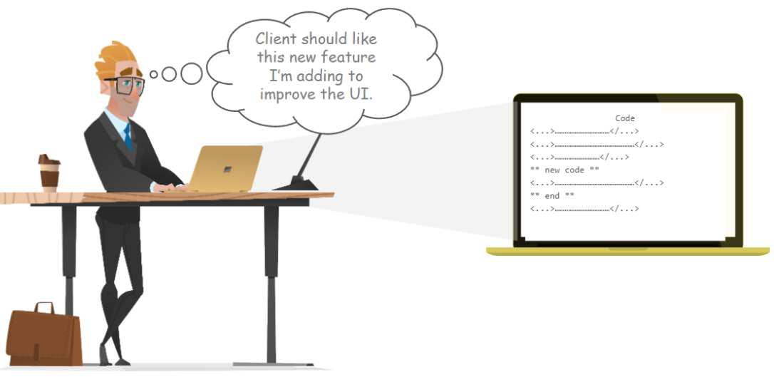
Scenario Without VCS
Dave is working on a new feature

Slide 4

Scenario Without VCS
Client didn’t like the new feature

Slide 5
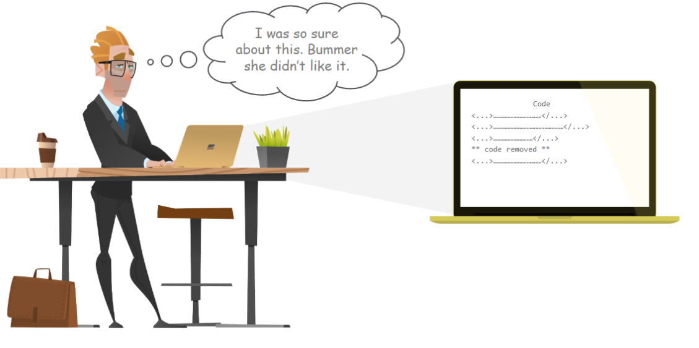
Scenario Without VCS
Dave delete the code and continue with the development

Slide 6
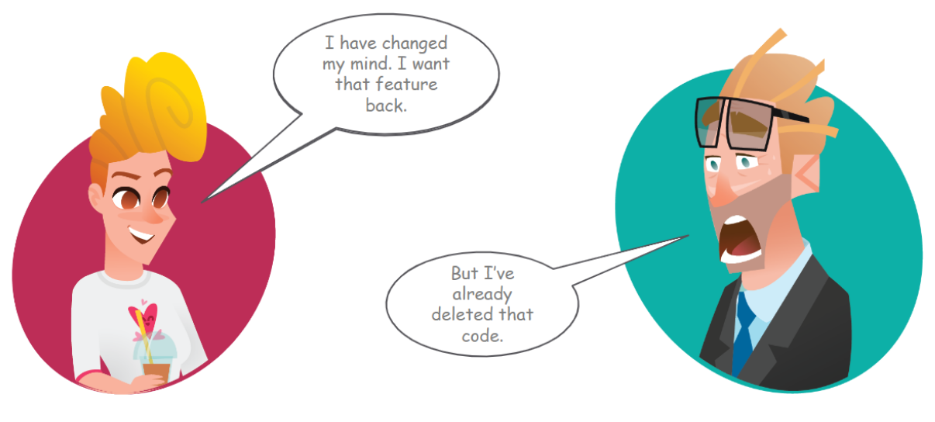
Scenario Without VCS
Dave is going crazy now because the client change his mind and he want the new feature back

Slide 7
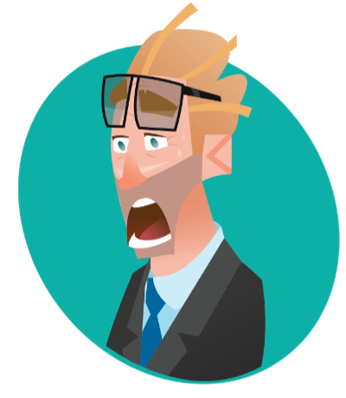
Scenario Without VCS
Once a is safe, all changes are permanent and cannot be reverted back
Lack of collaboration between team members
No centralized location where the code can be stored
It was very difficult to keep up with software version and software development efficiently
No record of what was done by whom
Downtime can occur because of a faulty update and this could cost millions dollars losses

Slide 8
Scenarios without Version Control System (VCS)

Slide 9
Scenario With VCS
Dave is working on a new feature

Slide 10
Scenario Without VCS
Client didn’t like the new feature

Slide 11
Scenario Without VCS
Dave delete the code and continue with the development

Slide 12
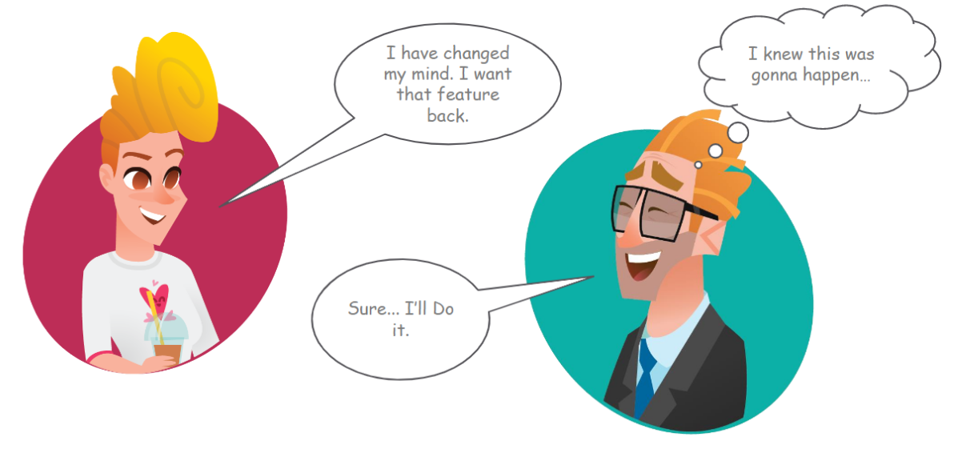
Scenario With VCS
Dave is similling now because he will take advantage of VCS when the client change his mind, and he want the new feature back

Slide 13
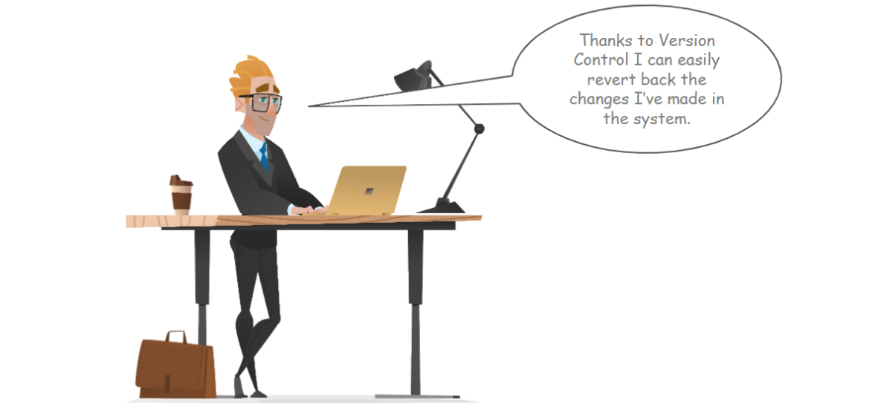
Scenario With VCS
Dave is happy with VCS because it makes life easy

Slide 14
What is VCS and it Benefits?

Slide 15
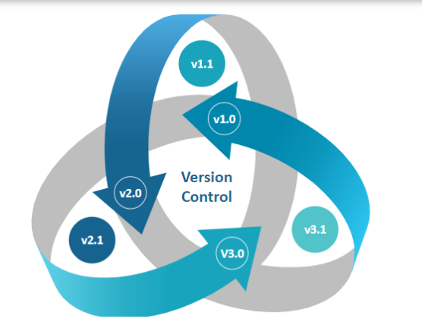
What is Version Control System (VCS)
VCS is a system that document changes made to a file or a set of files. It allows multiple users to manage multiple revision of the same unit of information.
Version control, also known as source control, is the practice of tracking and managing changes to software code. Version control systems are software tools that help software teams manage changes to source code over time.
A version control system records changes to files stored in the system. These files can be source code, assets, or other documents that might be part of a software development project. Teams make changes in groups called commits or revisions

Slide 16
Benefits Version Control System
Control System VCS allows you to:
Revert the code files back to their previous state
Recall and revert the entire project back to its previous state
Compare code changes over specific durations of time
Find who last modified a piece of code that might be causing an issue or a problem
Know who introduced a particular issue and when
Manage versioning of you code overtime
keep track of of all changes

Slide 17
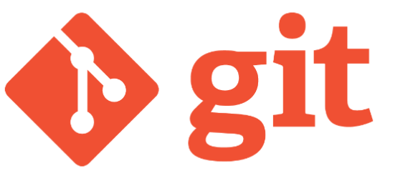
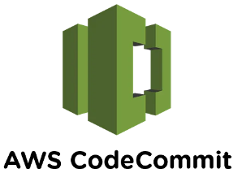

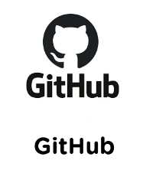


Tools for Version Control System

Slide 18
Centralized VCS and Distributed VCS

Slide 19
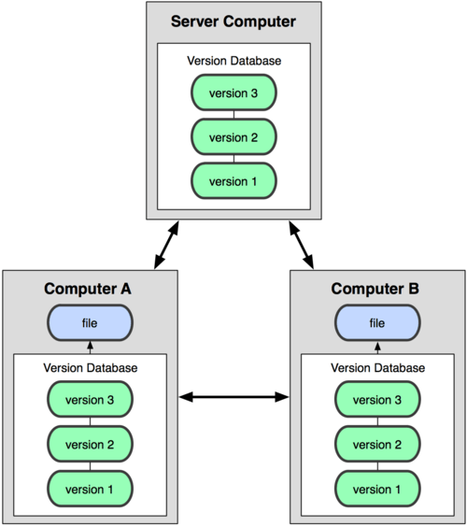

Centralize Vs Distributed VCS

Slide 20
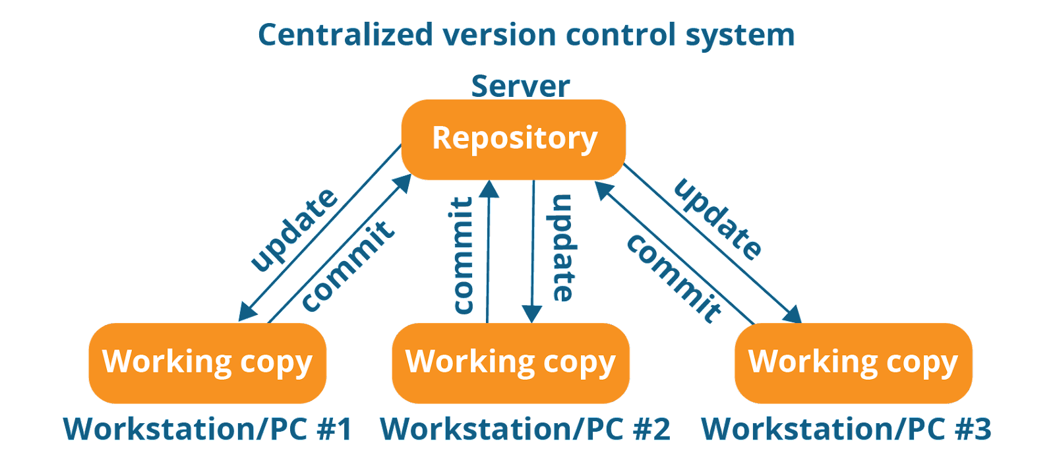
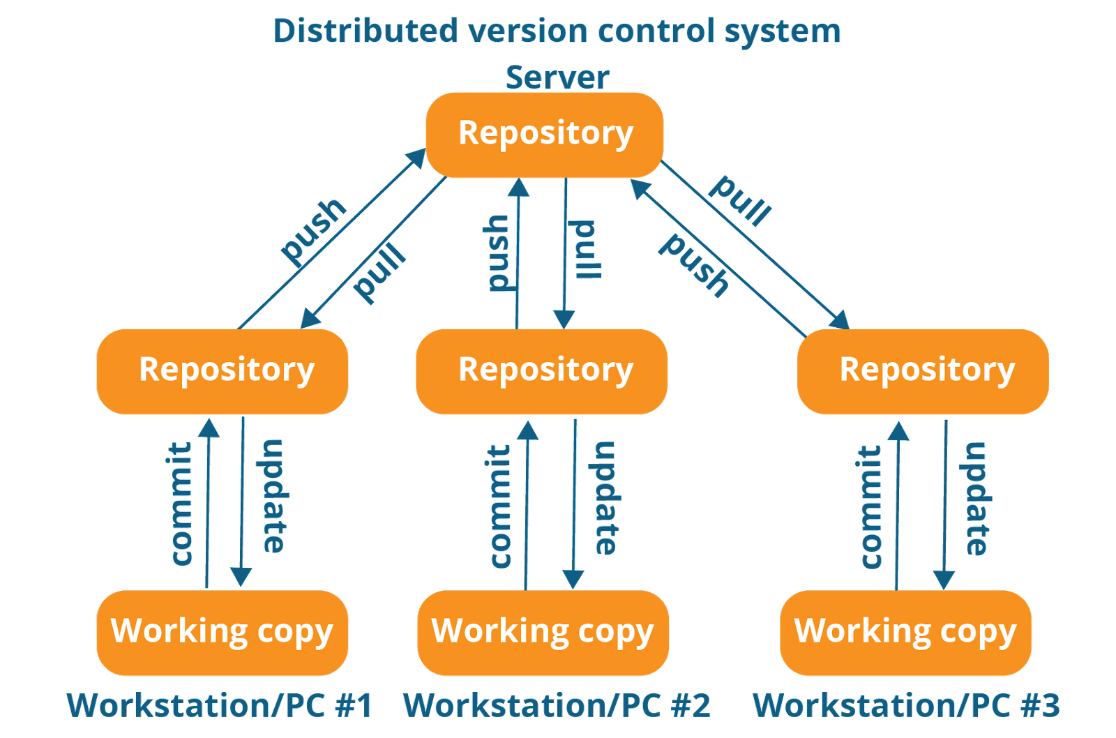
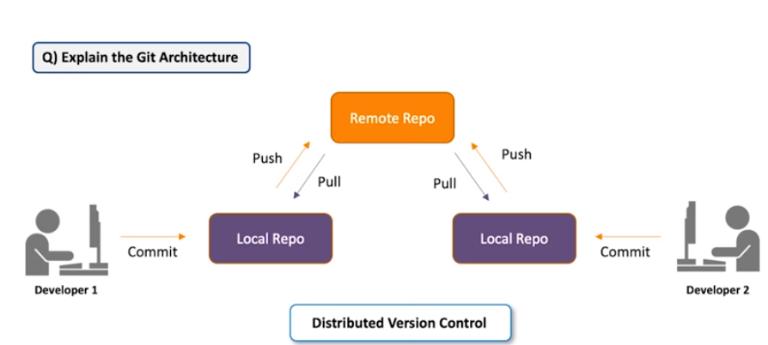
Centralize Vs Distributed VCS

Slide 21
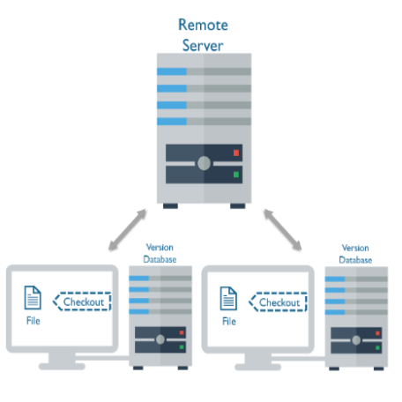
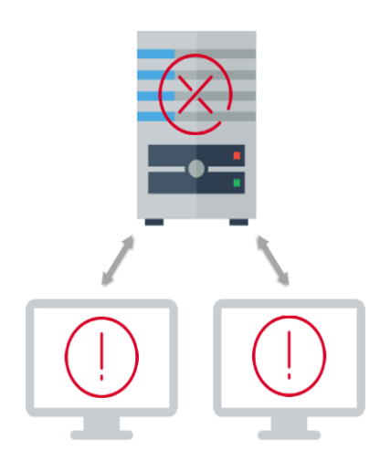
Centralize Vs Distributed VCS

Slide 22
Centralize Vs Distributed VCS
Unlike a centralized version control system, a distributed version control doesn’t have a single point of failure, because developers clone repositories on their distributed version control workstations, creating multiple backup copies. If the source code is corrupted, teams can use any developer’s clone as a backup, increasing security since there’s little risk of losing a project’s entire history. Also, because there are local copies, developers can commit offline, which offers flexibility in their personal workflow and prevents having to commit as a giant changeset. Distributed version control, such as Git, and Mercurial, offers fast branching, because there’s no communication with a remote server - everything is done on a local drive.
PS: The only communication with the remote server is when we want to push the code the remote server
A centralized version control system relies on a central server where developers commit changes. Centralized vcs, like Subversion, CVS, and Perforce store the copy of the code only on the remote server. Use need to be online to interact with the the remote server. Chances cannot not be done offline.
If the only copy of a project becomes corrupted or goes down, developers are unable to access the code or retrieve previous versions. Also, remote commits are extremely slow, because users must commit through a network to the central repository, which can slow down systems. Users must also be in network to push changes, limiting where and when developers can commit. Merging and branching are also difficult and confusing,

Slide 23
Repository in Git

Slide 24
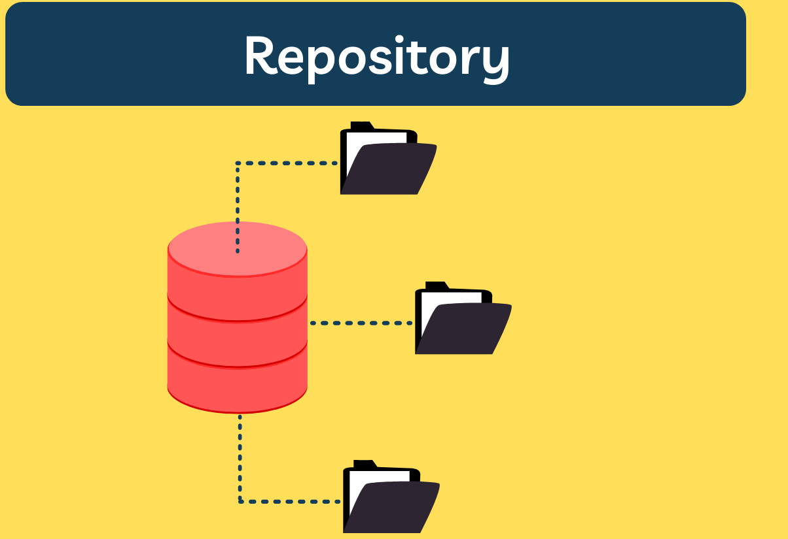
What is a Repository

Slide 25
Private Repository

Slide 26
Public Repository

Slide 27
Working with Local Repository

Slide 28
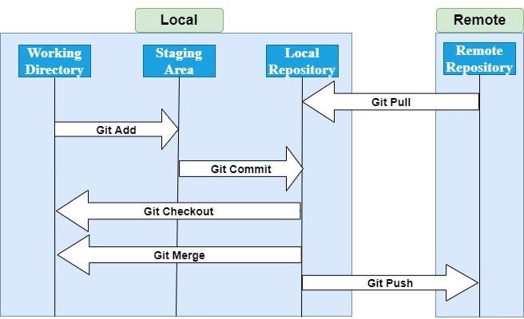
Git Workflow

Slide 29
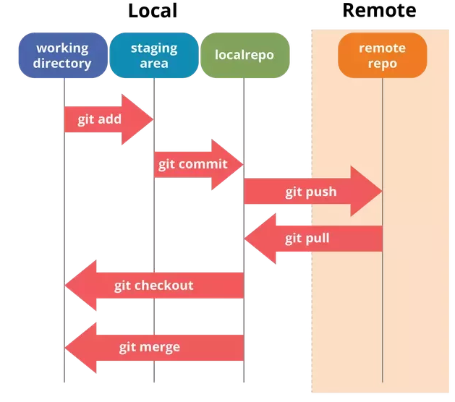
Git Init
git int
The git init command creates a new Git repository.
It can be used to convert an existing directory or unversioned project to a Git repository
It can be used to initialize a new, empty repository.
git init is one way to start a new project with Git. To start a repository, use either git init or git clone
git init: Transform the current directory into a Git repository
git init <directory>: Transform a directory in the current path into a Git repository

Slide 30
What is .git Directory?
.git directory
The .git folder contains all information that is necessary for the project and all information relating commits, remote repository address, etc.
It also contains a log that stores the commit history.
This log can help you to roll back to the desired version of the code
The .git folder will contain details of every single change made to the code base. All snapshots of the modifications will be recorded in this folder which makes it possible to undo the changes and rollback to the desired version of the code.
The .git folder is hidden to prevent accidental deletion or modification of the folder.
The version history of the code base will be lost if this folder is deleted. This means, we will not be able to rollback changes made to the code in future.

Slide 31
What is Git Config Command?
git config
git config --global user.email "you@example.com"
git config --global user.name "Your Name"

Slide 32
Git Add
git add .
git add -A

Slide 33
Git Status

Slide 34
Git Commit
git commit -m

Slide 35
Git Checkout
git checkout -b

Slide 36
Git branch
git branch -a
git branch

Slide 37
Git Log

Slide 38
Git Restore
git restore [file name]
git restore *

Slide 39
Git Branch -d
git branch --delete [branch name]
git branch -delete [branch name]

Slide 40
Git Stash
git branch --delete [branch name]
git branch -delete [branch name]

Slide 41
Authentication in Git

Slide 42
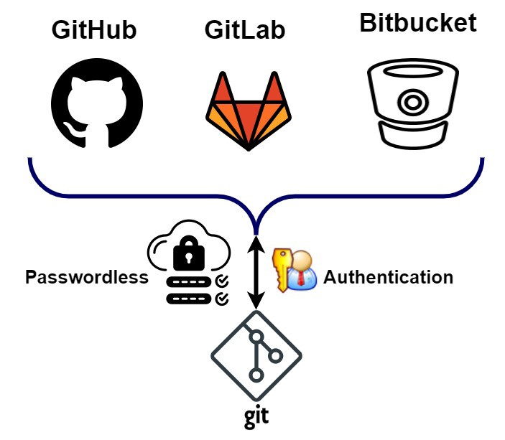

Password Authentication

Slide 43
Token Authentication

Slide 44
SSH Authentication

Slide 45
Working with Remote Repository

Slide 46
Git Push
push --set-upstream [branch name]

Slide 47
Git Clone

Slide 48
Git Pull

Slide 49
Git Revert

Slide 50
Git Reset

Slide 51
What is a Branch?

Slide 52
What is a Master or Main Branch?

Slide 53
What is a Develop Branch?

Slide 54
What is a Feature Branch?

Slide 55
What is a Release Branch?

Slide 56
What is Code Freeze?

Slide 57
What is a Protected Branch?

Slide 58
Create / Delete a Remote branch

Slide 59
What is .Gitignore File?

Slide 60
What is Readme File?

Slide 61
What is Readme File?

Slide 62
What is Fork in Git?

Slide 63
How to Manage a Repository Setting?

Slide 64
How to GitHub Global Setting?

Slide 65
How to Protect a Branch in GitHub?

Slide 66
What is PR or Pull Request?

Slide 67
What is Code Review?

Slide 68
How to Add a Collaborator In GitHub?

Slide 69
Tag In Git

Slide 70
What is a Tag?

Slide 71
Why tags are important?

Slide 72
How to Create a Tag?

Slide 73
Merge Conflict In Git

Slide 74
What is a Merge Conflict?

Slide 75
What is a Merge Occur?

Slide 76
How to Resolve a Merge conflict?

Slide 77

Today’s goal is to master Authentication in Git
3 ways to authenticate Github:
Personal access token
Username and password (HTTPS: This is the default one)
SSH

Slide 78
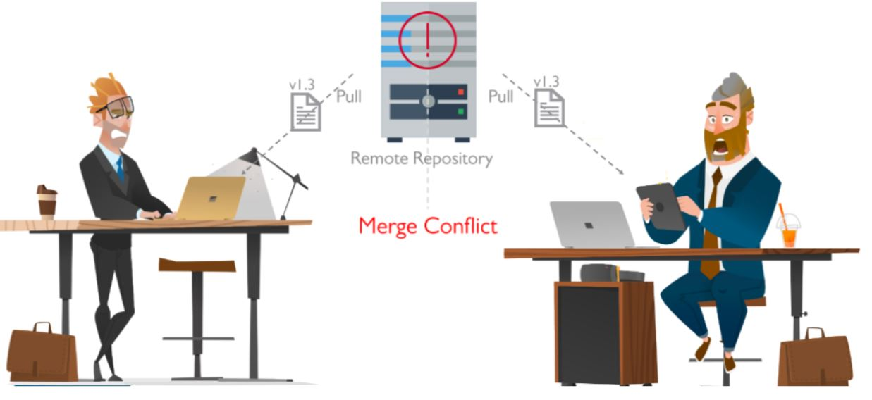
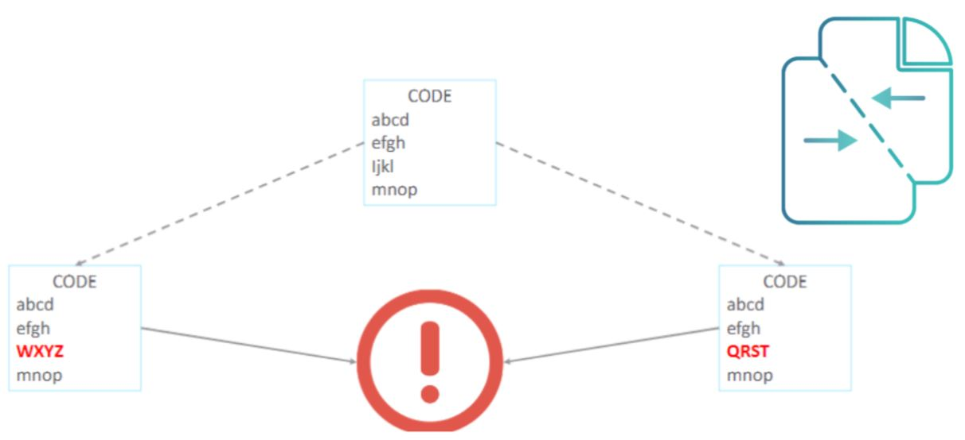
Today’s goal is to master Merge Conflict in Git, rubase, revert
Why do merge conflicts occur?
Merge conflicts arise when two files with the same content are modified and merged.
Merge conflicts can occur on merging branches
Git revert [commit ID]

Slide 79
Today’s goal is to master Git tag and .~/.gitconfig and README.md
Create tag with same name
git tag -a "tag name" -m "reference of commit"
git tag "tag name" "reference of commit"
example: git tag -a v1.0.0 -m "DevOps Easy Learning Website release v1.0.0"
Display or Show tags
git tag
Push tag to Github
git push -u origin <tag>
git push -u origin v1.0.0
# Terraform
**/.terraform/*
terraform.tfvars
*.tfstate
*.tfstate.*
*.terraform
backend.tf
provider.tf

Slide 80
Today’s goal is to master Git tag and .~/.gitconfig and README.md
Create tag with same name
git tag -a "tag name" -m "reference of commit"
git tag "tag name" "reference of commit"
example: git tag -a v1.0.0 -m "DevOps Easy Learning Website release v1.0.0"
Display or Show tags
git tag
Push tag to Github
git push -u origin <tag>
git push -u origin v1.0.0
# Terraform
**/.terraform/*
terraform.tfvars
*.tfstate
*.tfstate.*
*.terraform
backend.tf
provider.tf

